Slide 1

Online Voting System Using Django
By Mohammed Thanish
Python Fullstack Developer

Slide 2
Contents
Introduction | Feature Enhancement
Existing System | System Architecture & Technology Stack
Challenges in Existing System | Conclusion
Proposed System | Program
Features of Proposed System | Output
System Modules | Database

Slide 3
Introduction
An online voting system enables users to vote remotely.
It offers convenience and security compared to traditional voting.
Developed using Django framework and SQLite database.
Supports real-time result updates and user authentication.
Ensures transparency in the voting process.

Slide 4

Existing System
Traditional voting involves manual ballot papers.
Time-consuming process with human error possibilities.
Counting votes takes hours or even days.
Lack of accessibility for remote voters.

Slide 5
Challenges in Existing System
Manual vote counting leads to delays.
Inaccessible for people in remote locations.
Risk of vote tampering and manipulation.
High operational and administrative costs.
Increased workload for organized teams

Slide 6

Proposed System
An online voting platform built with Django.
Voters can register, login, and cast votes online.
Admins manage candidates via Django admin panel.
Secure, fast, and accessible from any location.
Reduces paper usage and manual errors.

Slide 7

Features of Proposed System
User registration and login system.
Vote casting with one vote per user.
Real-time result display with percentages.
Admin dashboard for managing candidates.
Age-based eligibility check before voting.

Slide 8
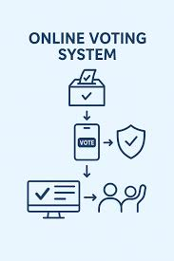
System Modules
User Module: Registration, login, vote, view results.
Admin Module: Add/edit/delete candidates.
Eligibility Module: Check age before voting.
Results Module: Calculates and displays percentages.
Authentication System: Validates voters.

Slide 9
Feature Enhancement
Add OTP/email-based login system.
Prevent double voting with session or token system.
Improve UI using JavaScript or front-end frameworks.
Visual graphs for result representation.
Extend system for large-scale voting system process.

Slide 10
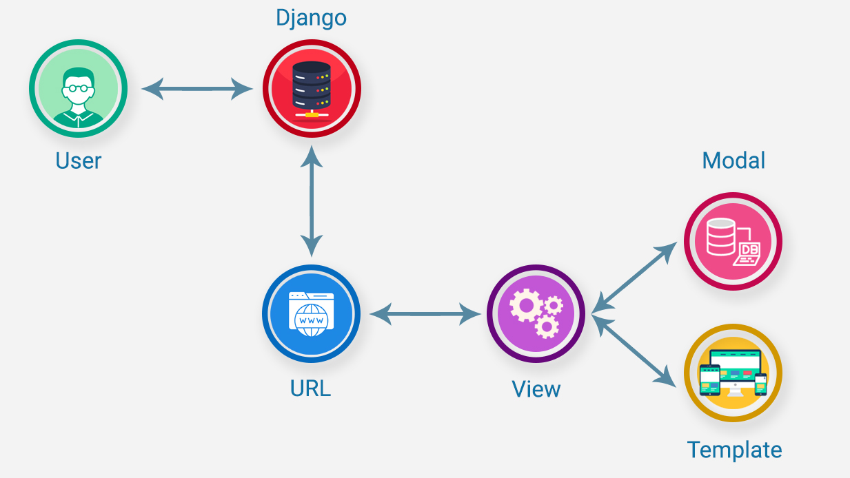
System Architecture & Technology Stack
Frontend: HTML, CSS, Bootstrap.
Backend: Django (Python).
Database: SQLite.
Authentication: Django's built-in system.
Architecture: MVC (Model-View-Controller).

Slide 11
Conclusion
The system digitizes voting for accessibility and speed.
Secure and scalable platform using Django.
Reduces human errors and ensures transparency.
Can be further enhanced for institutional use.
Promotes paperless and fair voting for elections.

Slide 12
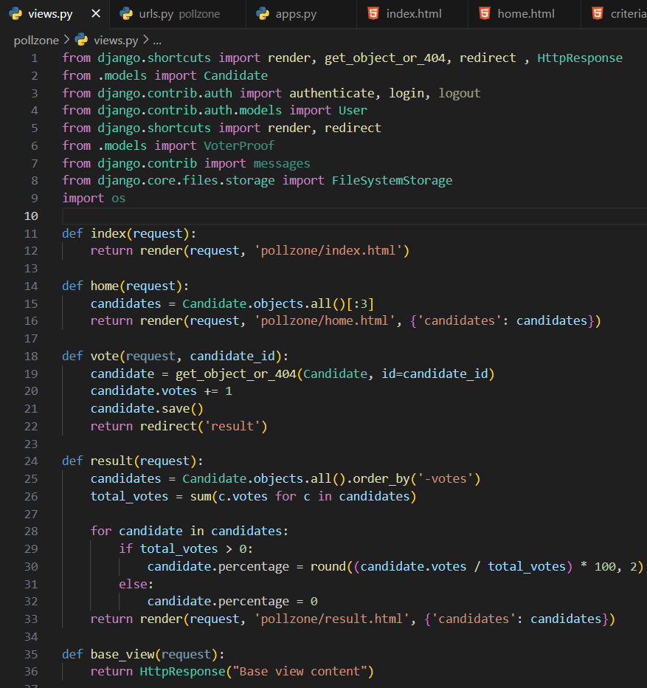
Program-Views

Slide 13
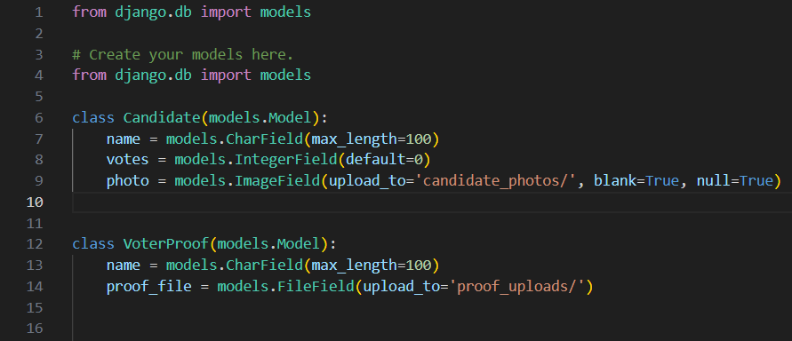
Program - Models

Slide 14
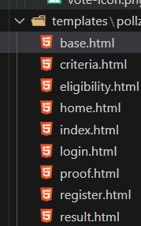
Program - Template

Slide 15
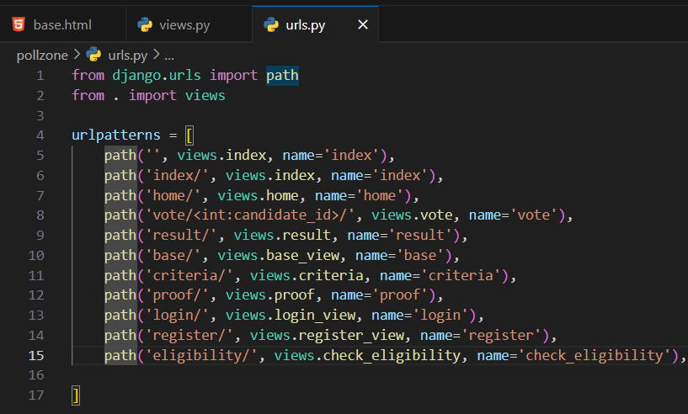
Program – Url(App)

Slide 16
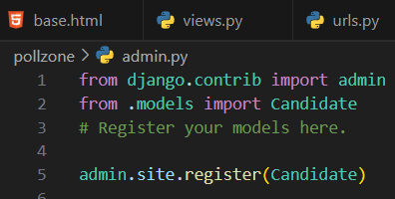
Program - Admin

Slide 17
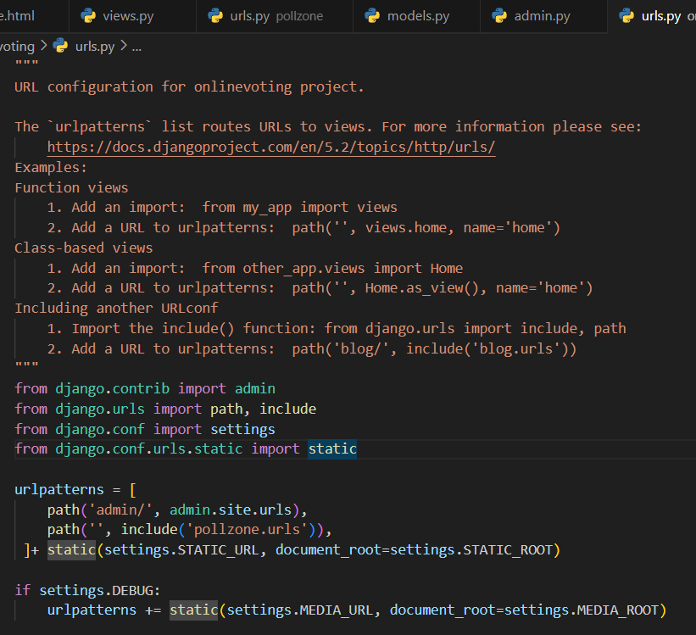
Program – Url(Project)

Slide 18
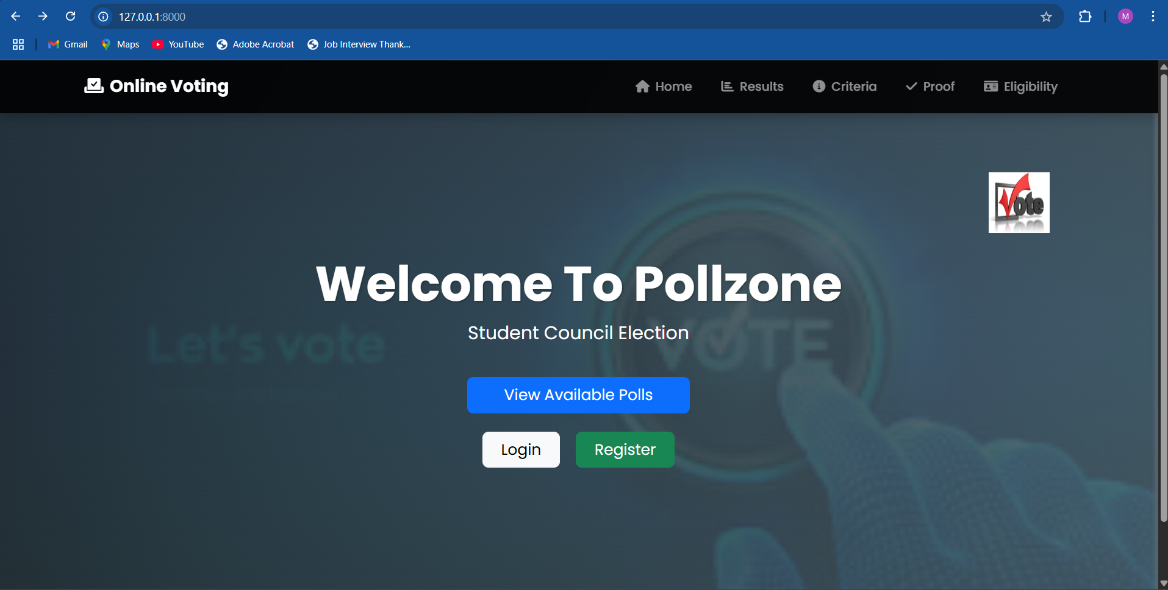
Output – Base Page

Slide 19
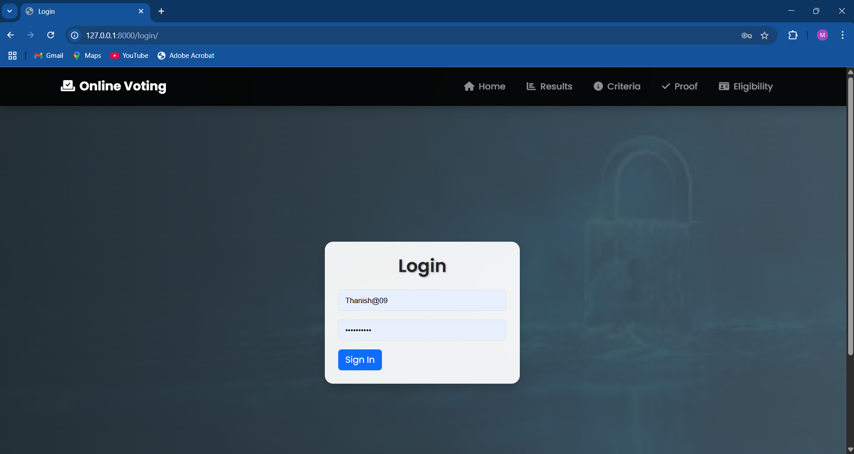
Output – Login Page

Slide 20
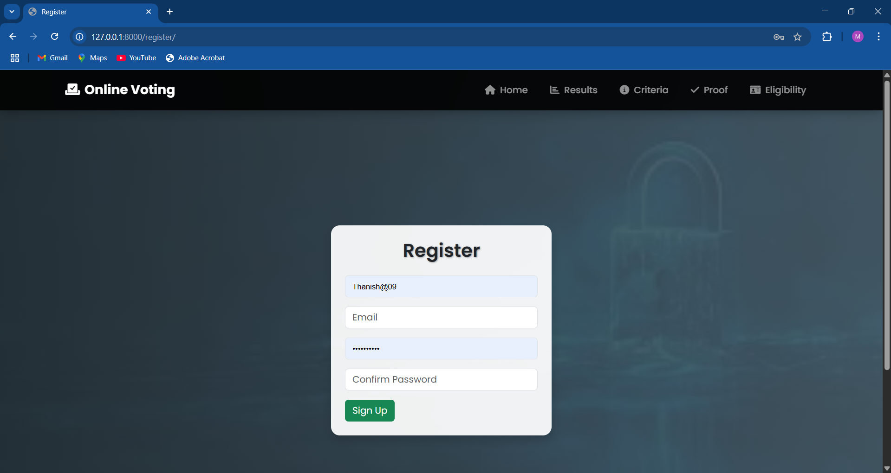
Output – Register Page

Slide 21
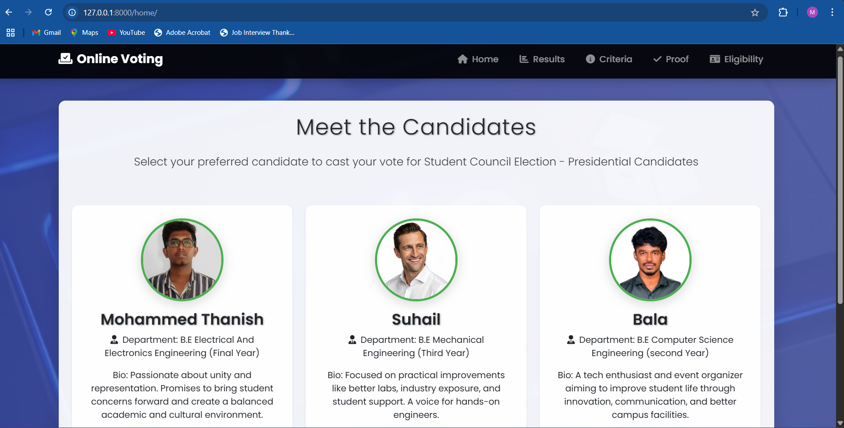
Output – Home Page

Slide 22
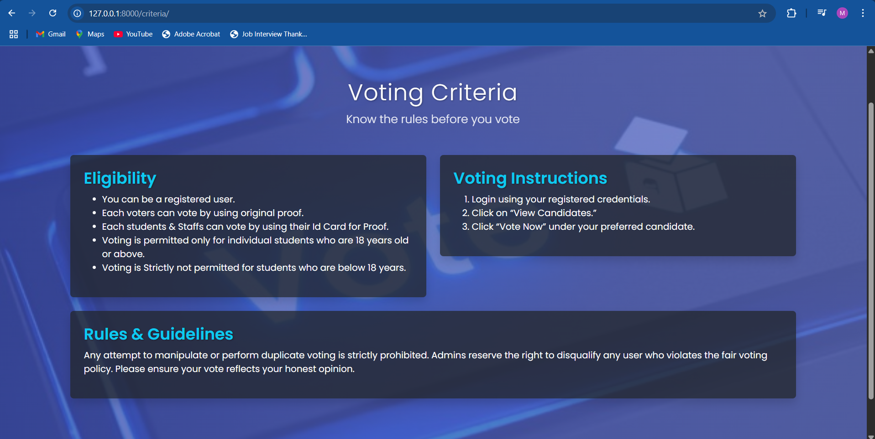
Output – Criteria Page

Slide 23
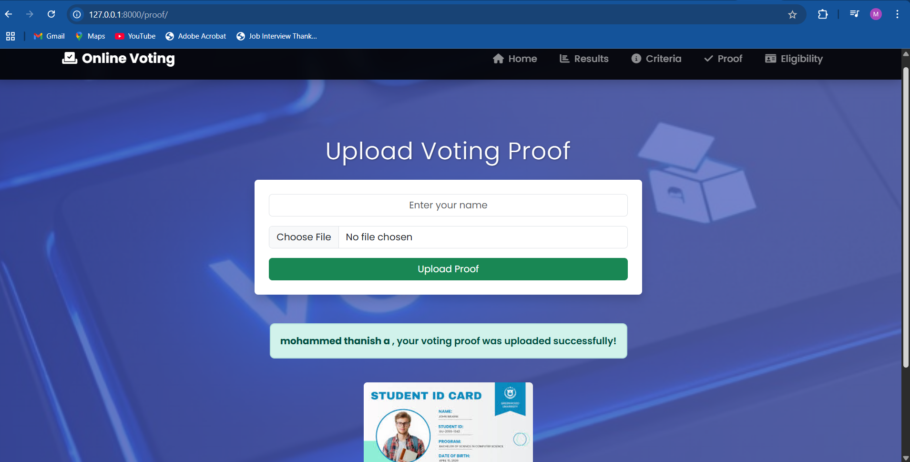
Output – Proof Page

Slide 24
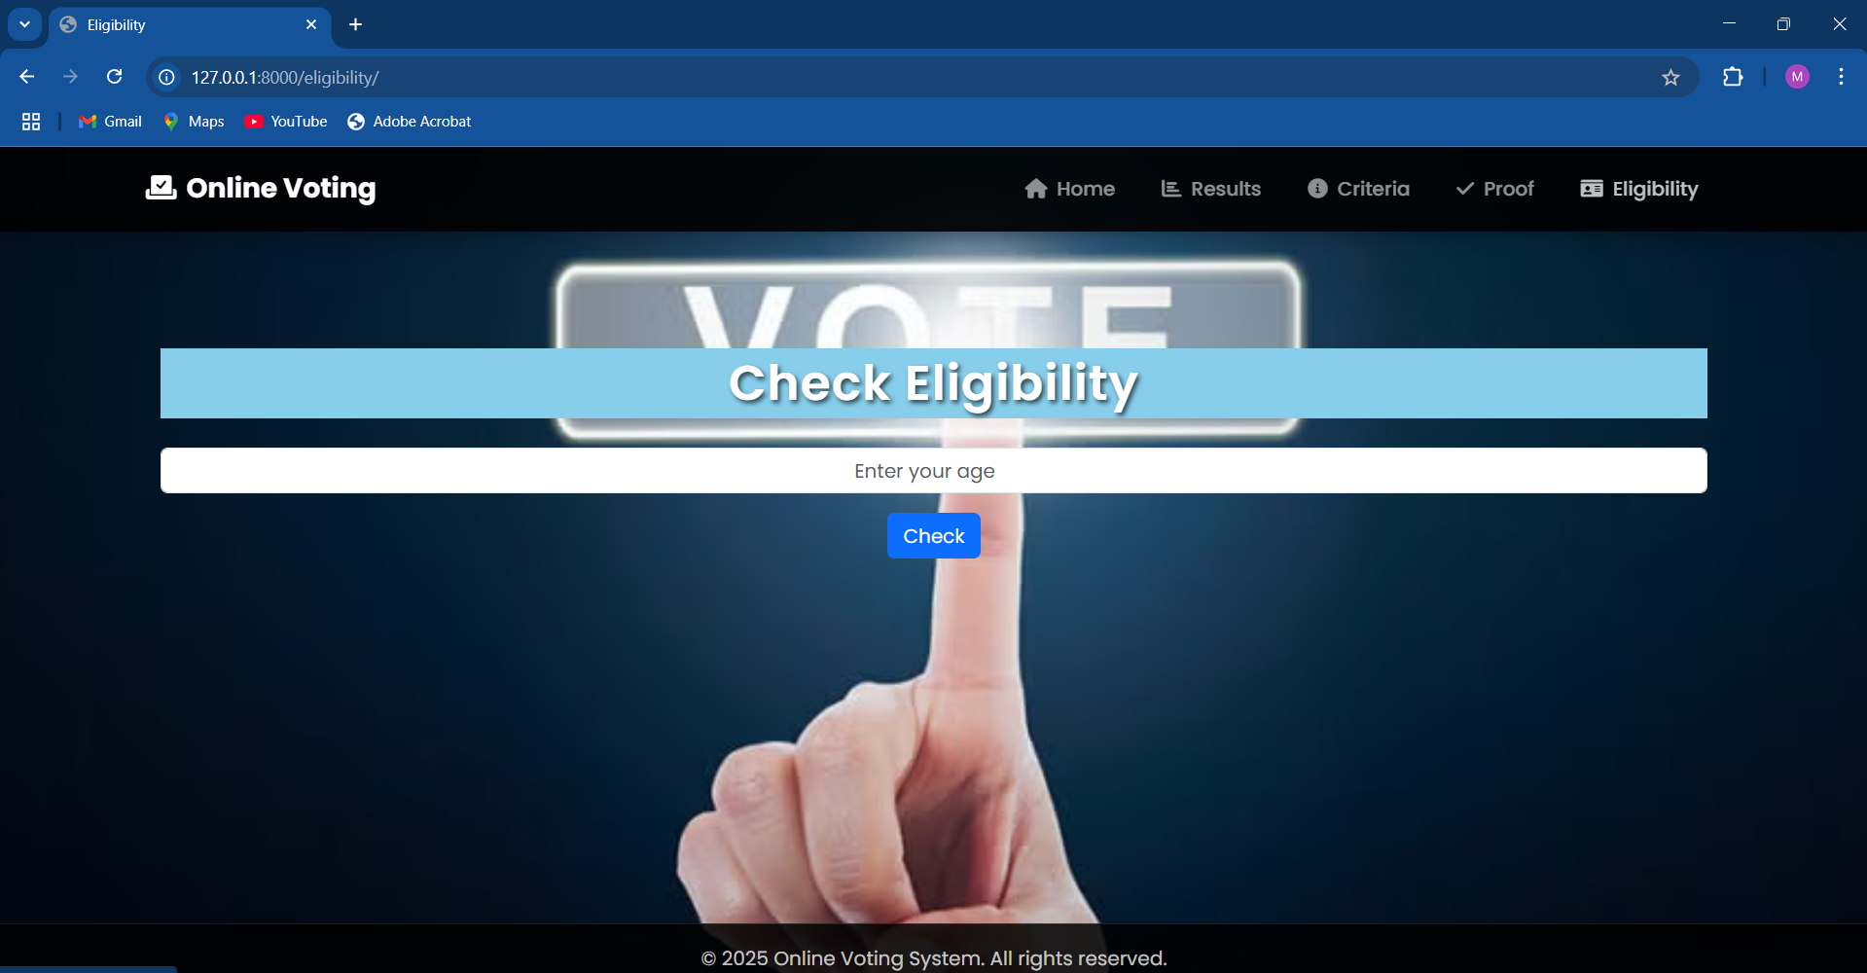
Output – Eligibility Page

Slide 25
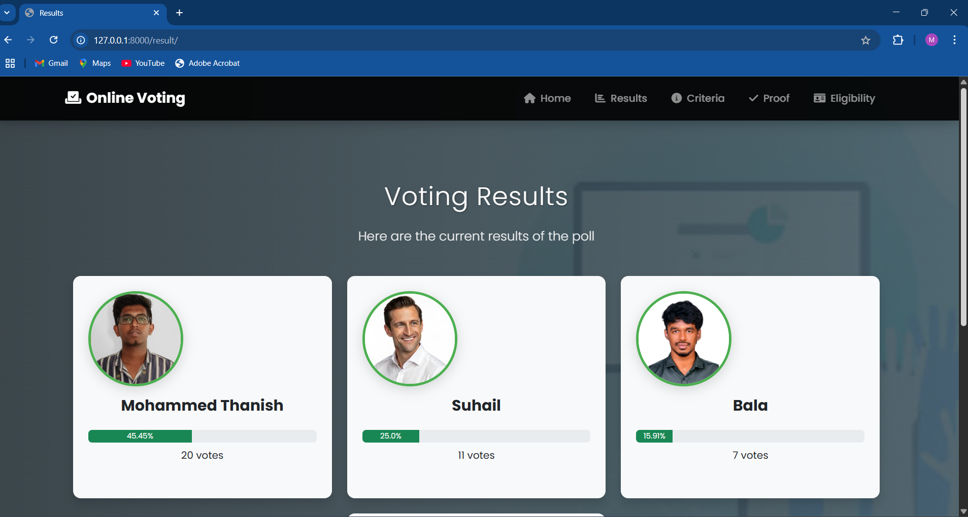
Output – Result Page

Slide 26
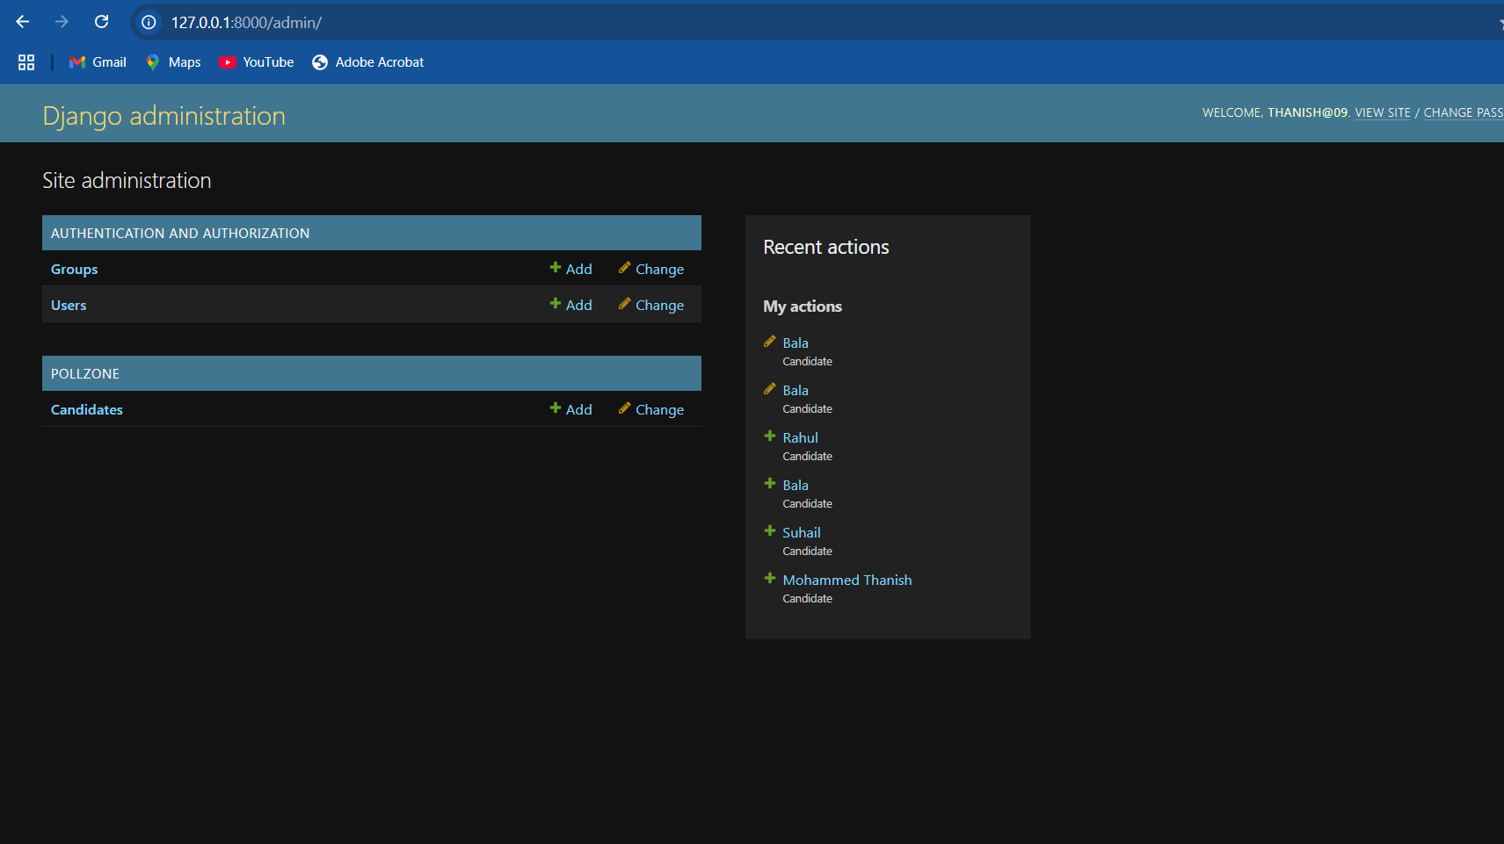
Database– Admin Page

Slide 27
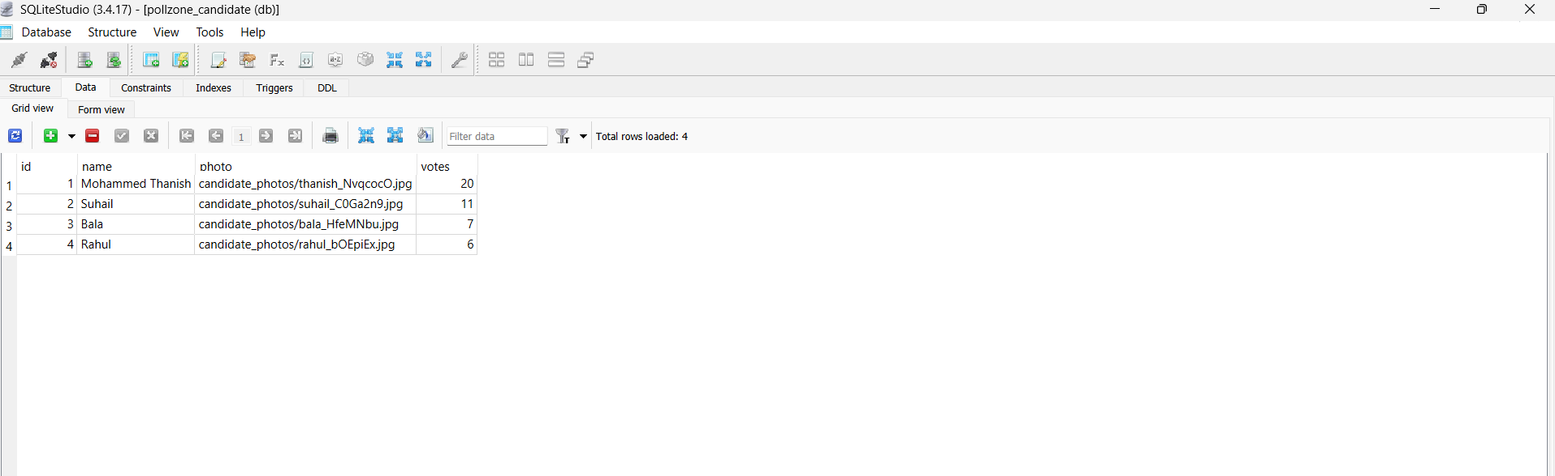
Database– SQLLite

Slide 28


